Slide 1
Nodejs

Slide 2
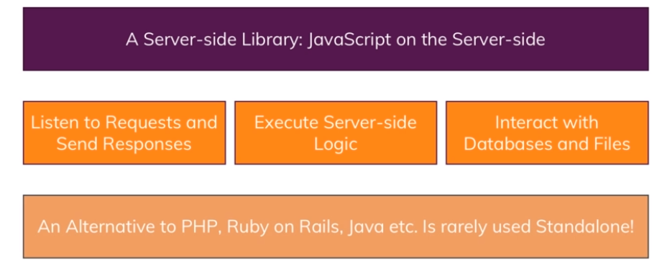
What is Nodejs

Slide 3
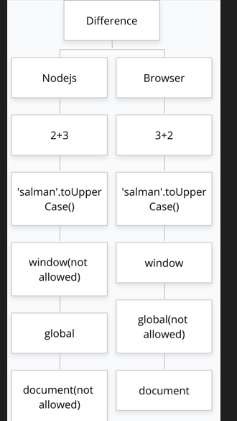
Javascript on Browser and Nodejs

Slide 4
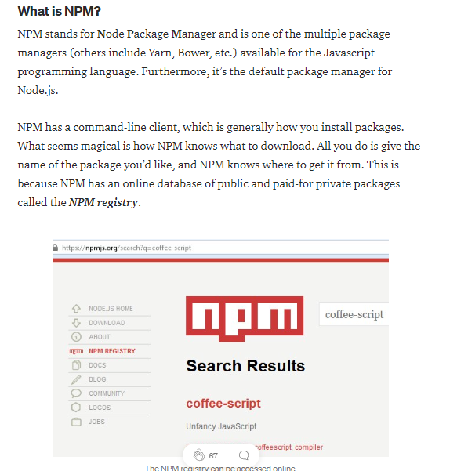
What is NPM

Slide 5
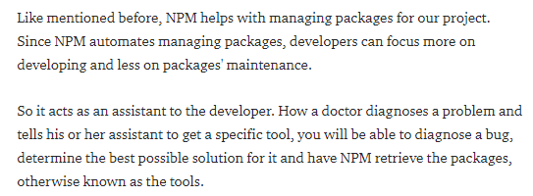
What purpose Does NPM Server?

Slide 6
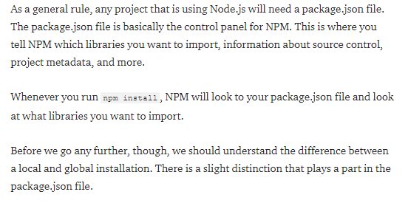
High-Level Overview of NPM

Slide 7
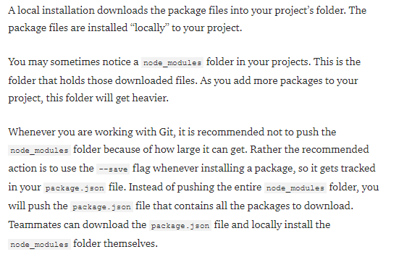
Local Installation

Slide 8
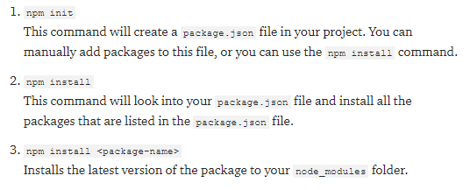
Basic Command

Slide 9
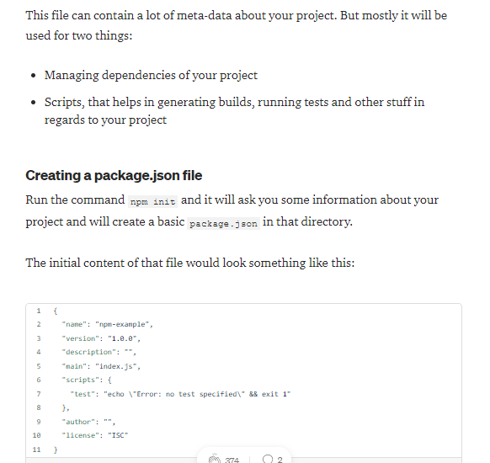
What isPackage.json?

Slide 10
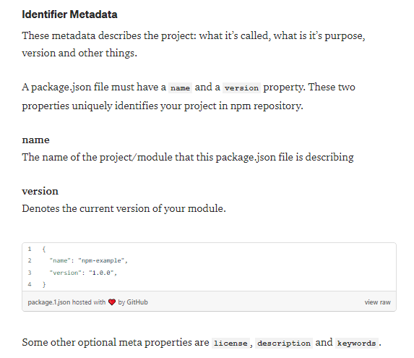
Inside the package.json

Slide 11
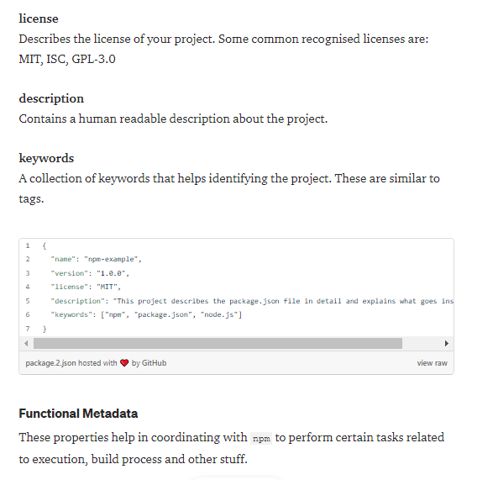
Inside the package.json

Slide 12
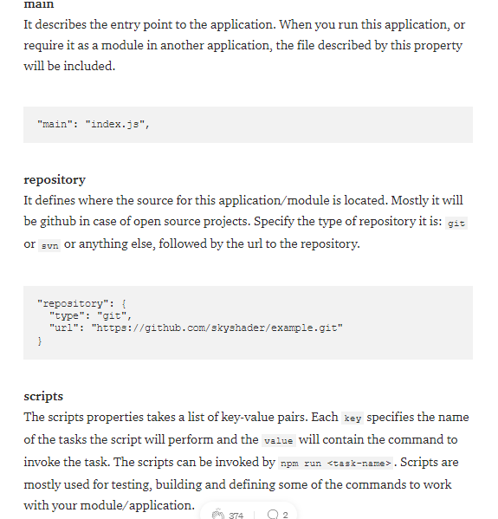
Inside the package.json

Slide 13
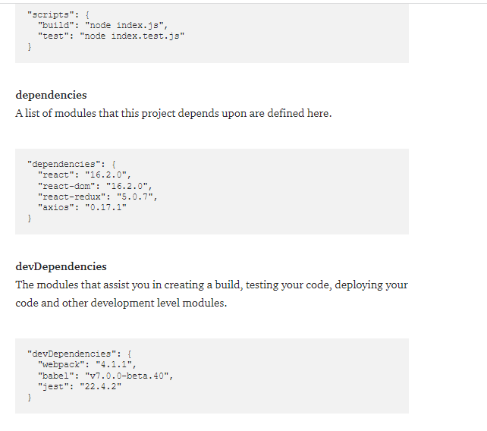
Inside the package.json

Slide 14
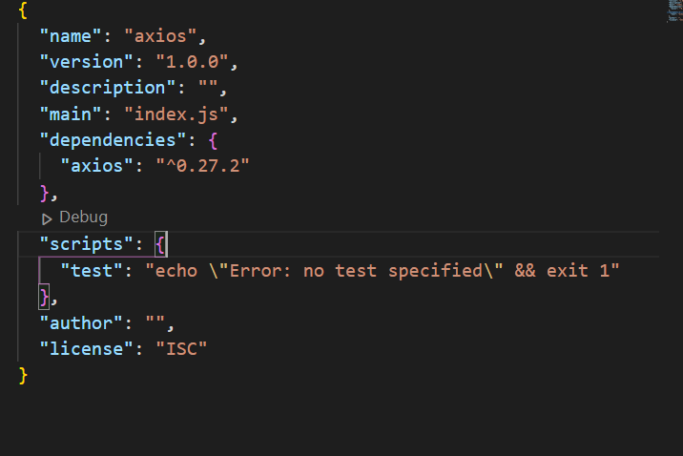
Final version of package.json

